Slide 1


“Infomediaries in the Internet Era”
CONCERT 2001
Ginny Hendricks
Electronic Products Manager
Asia Pacific, Middle East, Africa

Slide 2
Agenda
About Swets Blackwell
The Role of the Infomediary
Swets Blackwell and eProcurement
Swets Blackwell and eAccess
“Consortia Services”
“Professional Services”

Slide 3
Agenda
About Swets Blackwell
The New Role of the Infomediary
Swets Blackwell and eProcurement
Swets Blackwell and eAccess
“Consortia Services”
“Professional Services”

Slide 4
Swets Blackwell
July 2000: Blackwell’s Information Services + Swets Subscription Services = Swets Blackwell
Over 100 years of experience in providing information services and solutions
Merged p & e services
Defined an ambitious e-strategy
July 2001: Partnership with IBM
Currently implementing our new
strategy...

Slide 5
Agenda
About Swets Blackwell
The New Role of the Infomediary
Swets Blackwell and eProcurement
Swets Blackwell and eAccess
“Consortia Services”
“Professional Services”

Slide 6
The Role of the Infomediary
When the Internet became a serious delivery route for information, the role of subscription agents was the first to be questioned:
  Faster & cheaper to go direct?
  Do agents “add value”?
After completion of the merger, we asked
ourselves the same questions.
Then we asked our customers
Then we asked our publishers

Slide 7
The Role of the Infomediary
Internet delivery of journals has made our service richer but our industry more complex, not less complex:
  complex authentication issues
  complex infrastructural issues
  complex to compile usage data
  complex licenses, often restrictive
  budgetary issues
  etc…
  These are all incredibly time consuming
This is where we can step in!

Slide 8
The Role of the Infomediary
SB redefining our role entirely, building
on existing service & experience:
SB e-services fall into two main focus areas...
  eProcurement
  eAccess
Also…
  “Consortia Services”
  “Professional Services”

Slide 9
Agenda
About Swets Blackwell
The New Role of the Infomediary
Swets Blackwell and eProcurement
Swets Blackwell and eAccess
“Consortia Services”
“Professional Services”

Slide 10
SB and eProcurement
New service SwetsWise developed together with IBM Global Business Innovation Services
Launched in North America and UK 17th September 2001
Launch in Taiwan 2002 (Q2 ??)
Aimed at corporate organisations but
library subs management services (DataswetsConnect) to be
integrated end of 2002

Slide 11
SB and eProcurement: SwetsWise
www.swetswise.com
Fully searchable on-line catalogue of the entire SB database (250,000+ records)
Customised catalogues - add or eliminate subject categories and sub subject categories per account
Real-time account data and real-time list prices
Preparation of quotes on-line
Central ordering, desk-top ordering, proxy ordering
E-payment authorisation, credit card payments
Subscription management services - renewals,
claims, cancellations, approval procedure…
Links from your own eProcurement system
Intuitive and user-friendly interface

Slide 12
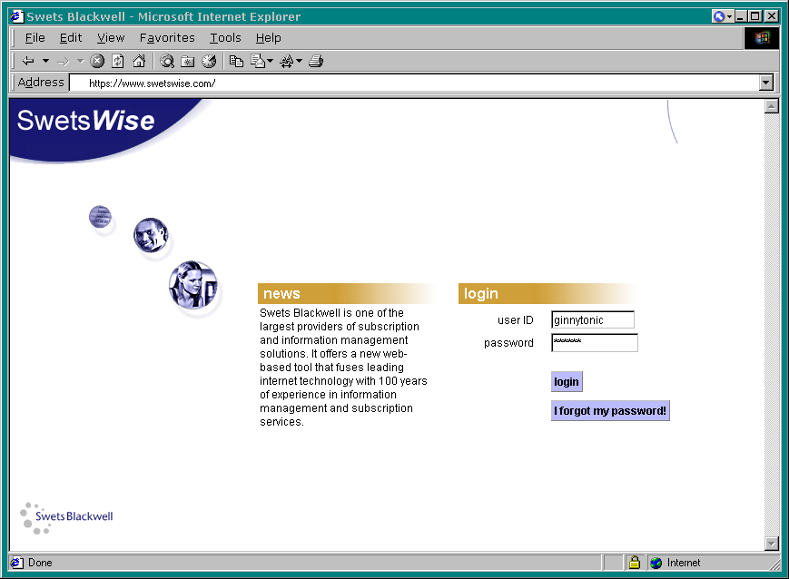

Slide 13
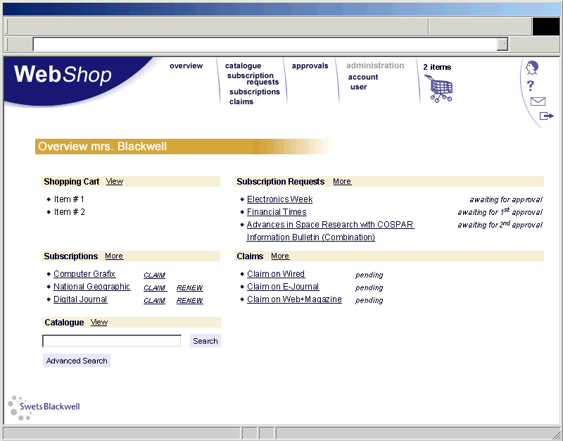


Slide 14
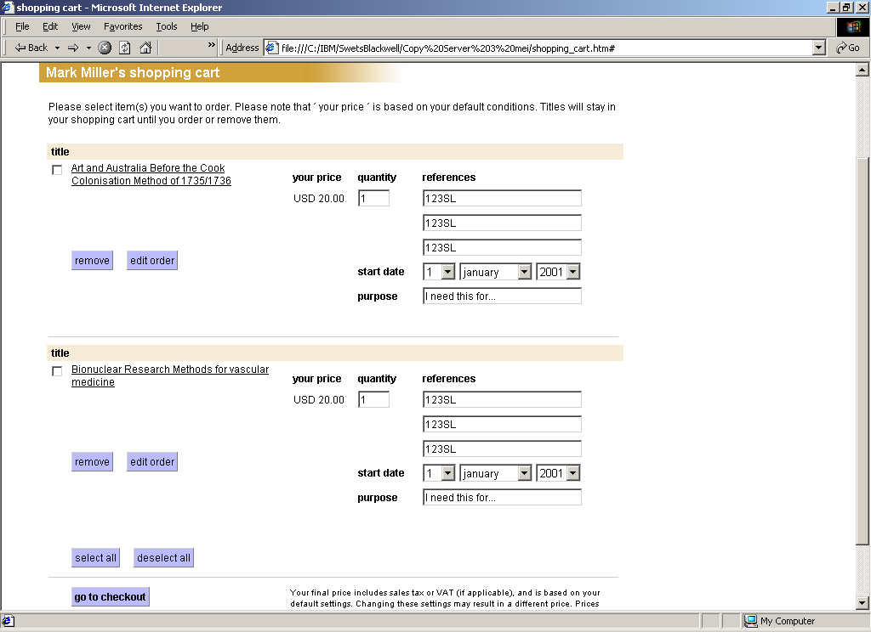

Slide 15
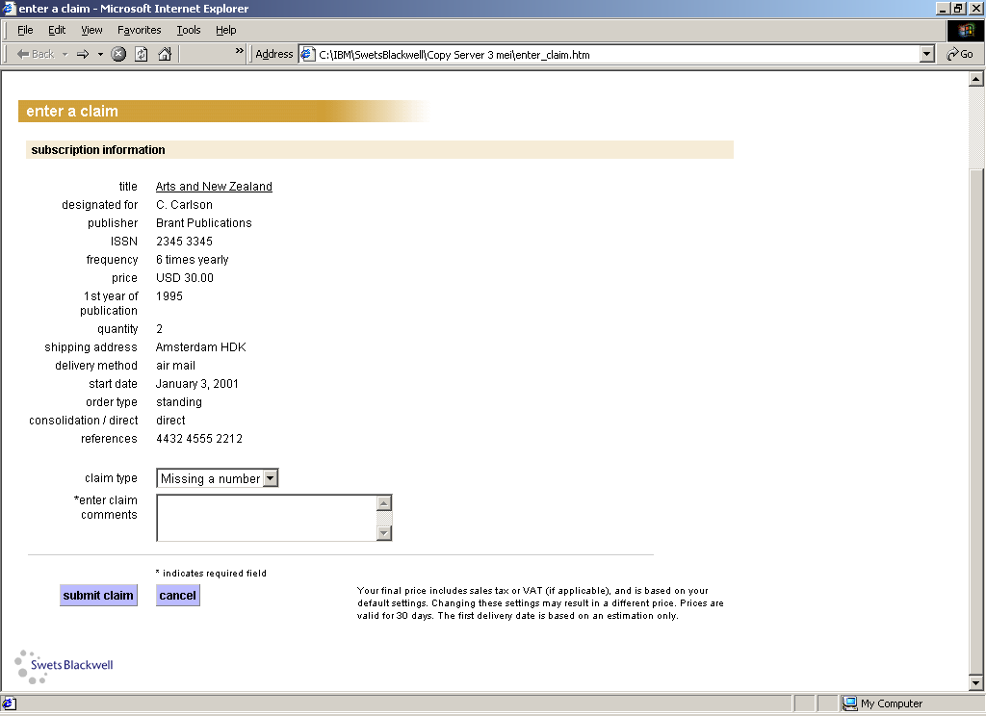

Slide 16
Agenda
About Swets Blackwell
The New Role of the Infomediary
Swets Blackwell and eProcurement
Swets Blackwell and eAccess
“Consortia Services”
“Professional Services”

Slide 17
SB and eAccess
In addition to our regular eAccess services e.g...
  Automatic access to free with print journals
  Or your permission requested via regular bulletins (p&e)
  Reports on what you can access electronically and for how much
Just as we have our FASTPlus service for consolidation of print journals, we also offer a consolidation service for electronic journals:
SwetsnetNavigator

Slide 18
SB and eAccess: SwetsnetNavigator
18,000 journal titles held at TOC level
  Well established eTOC alerting service
  Available as subject-specific packages
  Specially requested titles can easily be added “Exotic Titles”
6,000 of these are full text
Now have agreements with 186 publishers
e-mailed SDIs
Links from over 300 secondary databases, and growing
Standard SnN URLs for linking directly
from your OPAC to the full text

Slide 19
SB and eAccess: SwetsnetNavigator
CrossRef affiliate member (December 2000)
Auto-claim system (March 2001)
  Dead links reduced by 95%
SFX Compatible (April 2001)
DocDel links (June 2001)
IBM collaboration (July 2001)
Links to Elsevier Science’s ScienceDirect (September 2001)
ProQuest agreement (October 2001)

Slide 20
SwetsnetNavigator: DocDel Feature
Launched June 1st 2001
Aimed to enhance TOC Full File (18,000 titles)
Links to three DocDel vendors:
  CISTI
  Infotrieve
  The British Library
Activate permissions at dept and/or user level
All invoicing/delivery responsibility still
lies with the DocDel vendor
SnN provides the convenient link in
the appropriate places

Slide 21
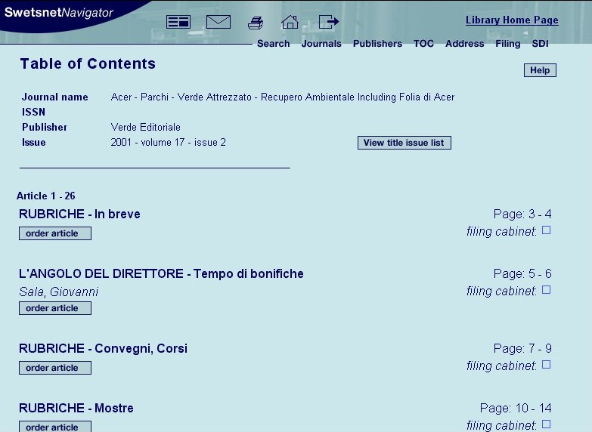

Slide 22
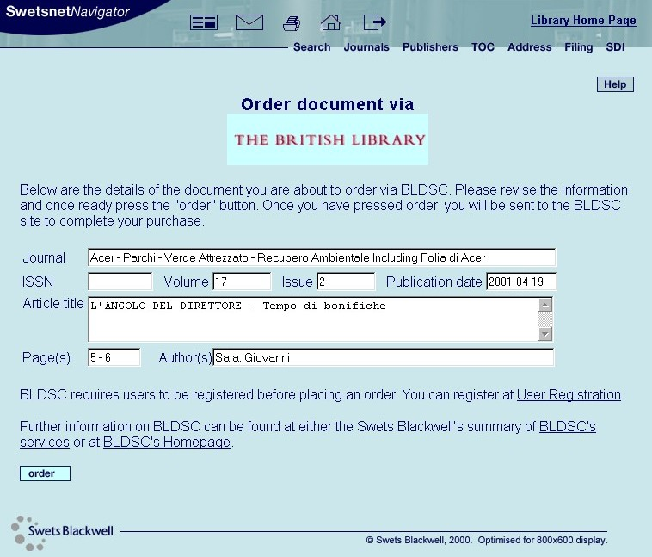

Slide 23
Agenda
About Swets Blackwell
The New Role of the Infomediary
Swets Blackwell and eProcurement
Swets Blackwell and eAccess
“Consortia Services”
“Professional Services”

Slide 24
SB “Consortia Services”
Consultancy...
  Help to define the consortium
  Analyse holdings and define shortlist/prioritise relevant content & publishers
  Trials and demonstration days
Mediation / Negotiation...
  Obtaining favourable prices and terms
  Customised quotations and proposals; explanation; mediation
  License management
Subscription services...
  Subscription/administration services
  Maintenance of the consortium
Gateway service SnN

Slide 25
Agenda
About Swets Blackwell
The New Role of the Infomediary
Swets Blackwell and eProcurement
Swets Blackwell and eAccess
“Consortia Services”
“Professional Services”

Slide 26
SB “Professional Services”
Working on new “professional services” in addition to our traditional subscription services, our e-access and e-commerce activities.
Professional Services will help you...
  Choose the right content
  License the right content
  Make the content accessible for your users
  Help you monitor usage behavior
Examples…
  Management Reporting
  Building Vertical Portals

Slide 27
thank you for listening!
Any Questions ??
GHendricks@nl.SwetsBlackwell.com

